Slide 1



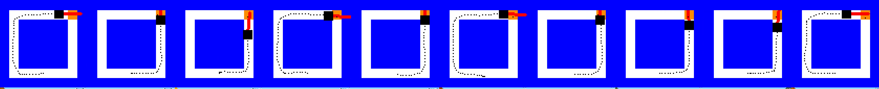
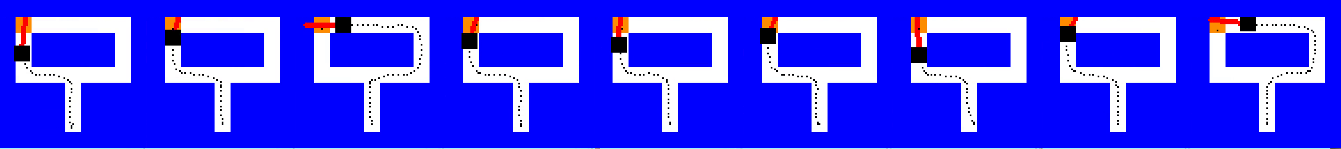
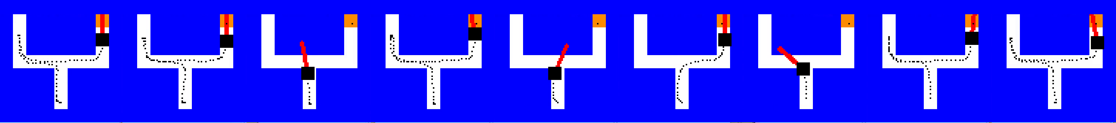
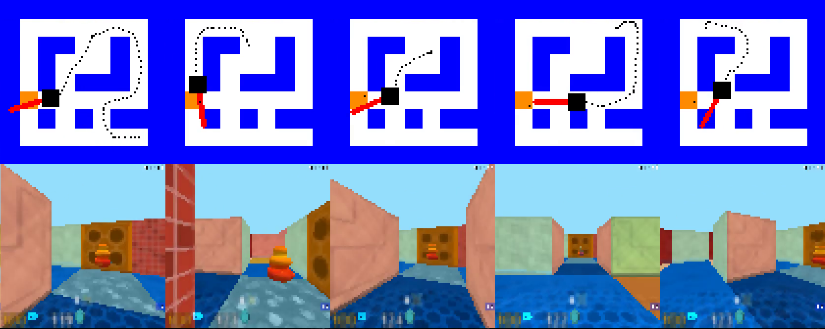
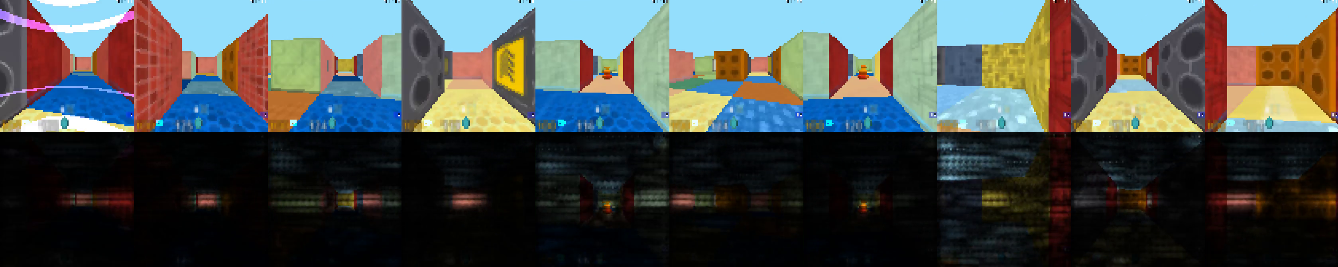
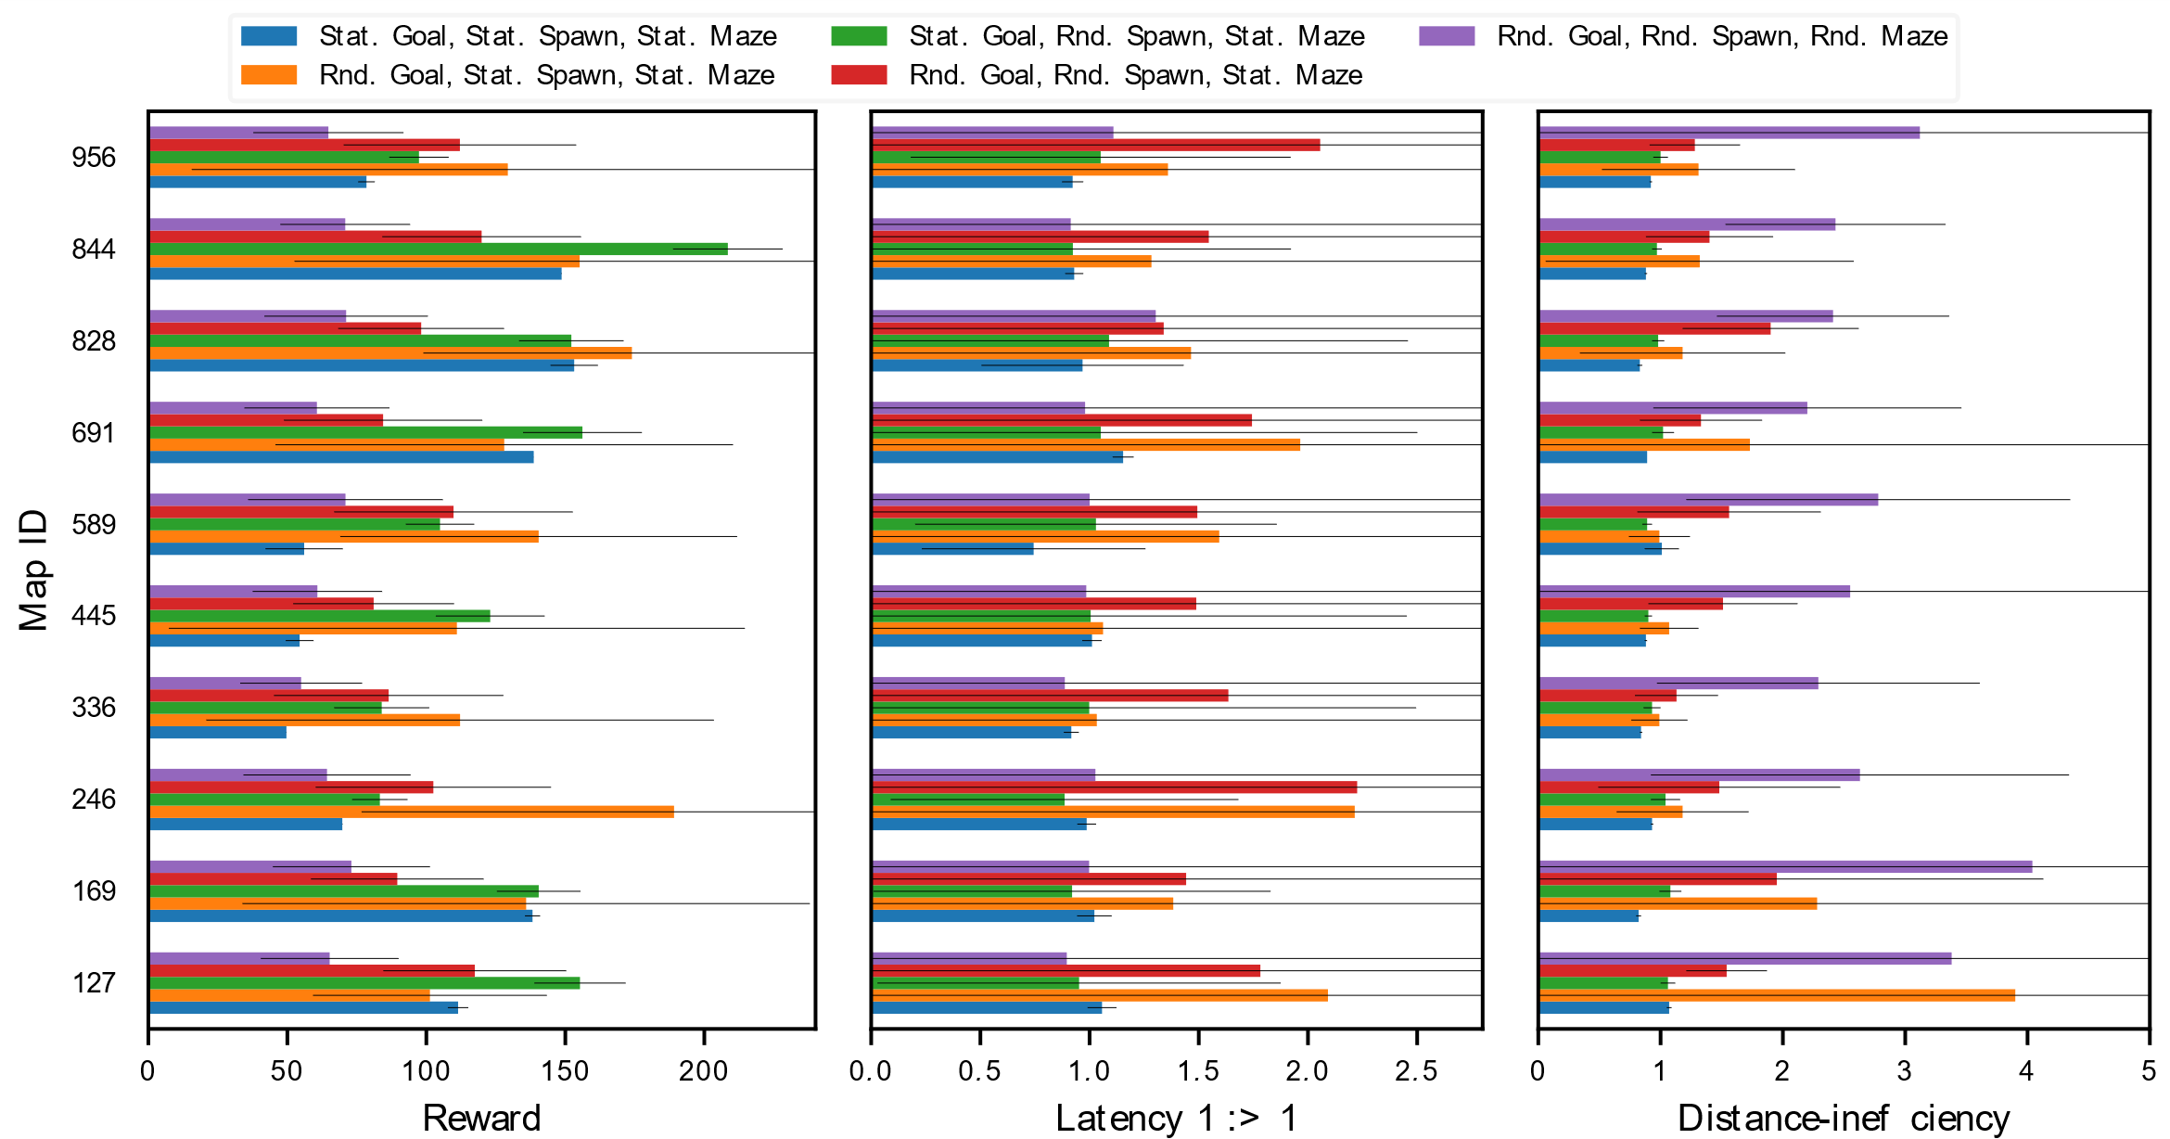
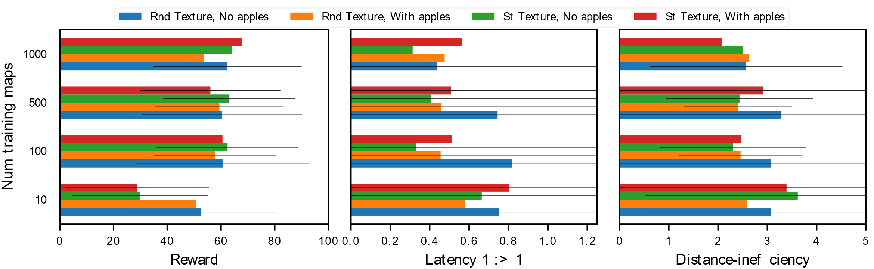
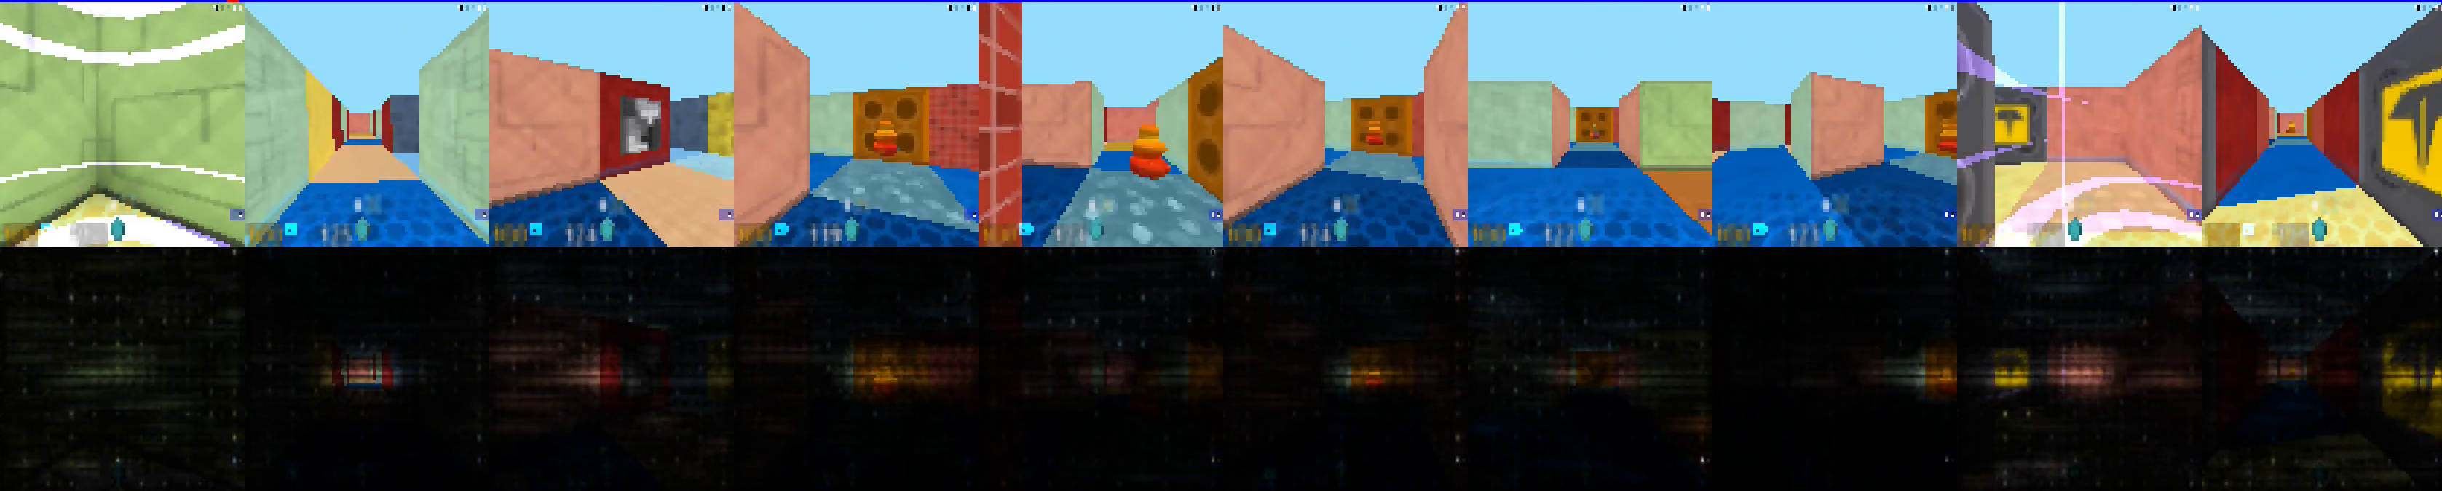
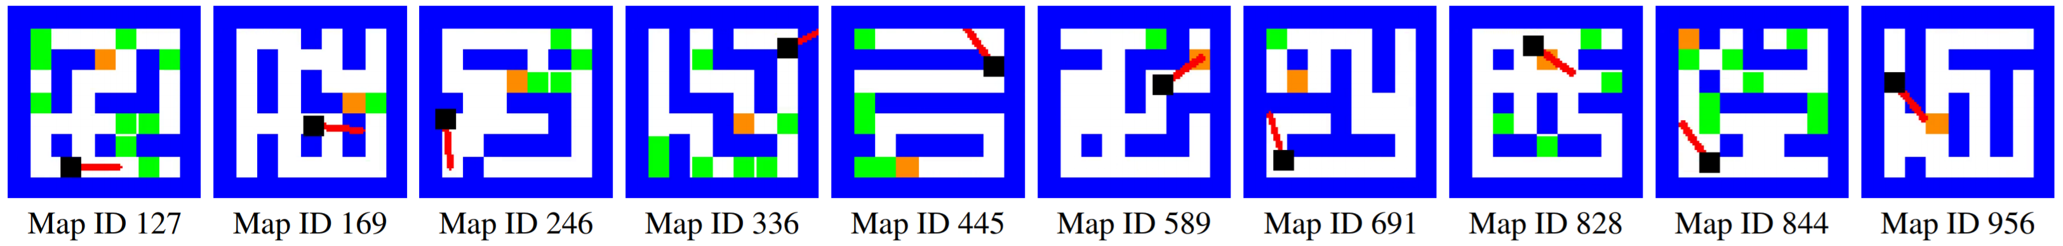
Do deep reinforcement learning algorithms really learn to navigate?
Shurjo Banerjee*, Vikas Dhiman*, Brent Griffin and Jason J. Corso
Electrical Engineering and Computer Science, University of Michigan, Ann Arbor, MI
{shurjo,dhiman,griffb,jjcorso}@umich.edu
What does it mean to navigate?
Experiments: Accuracy and Median Error
Where is the Kitchen? (Mapping)
Where am I relative to Kitchen? (Localization)
What is the shortest path to Kitchen? (Path-planning)
How do I execute the shortest path? (Control)
Learning to navigate (Mirowski et al 2017)
Environment setup
Qualitative Results
Experiments: Error Histograms
Fig 1. Screen shots from Deepmind lab environment.
References
[1] Piotr Mirowski, Razvan Pascanu, Fabio Viola, Hubert Soyer, Andrew J. Ballard, Andrea Banino, Misha Denil, Ross Goroshin, Laurent Sifre, Koray Kavukcuoglu, Dharshan Kumaran, and Raia Hadsell. Learning to navigate in complex environments. CoRR, abs/1611.03673, 2016. URL http://arxiv.org/abs/1611.03673
[2] Charles Beattie, Joel Z Leibo, Denis Teplyashin, Tom Ward, Marcus Wainwright, Heinrich Küttler, Andrew Lefrancq, Simon Green, Víctor Valdés, Amir Sadik, et al. Deepmind lab. arXiv preprint arXiv:1612.03801, 2016.
Fig 3. The 10 randomly selected maps from the training set.
Fig 2. Modified Nav-A3c-D1-D2-l architecture.
Acknowledgements
This work was partially supported by the Denso Corporation, NSF CNS 1463102, and DARPA W31P4Q-16-C-0091.

Slide 2
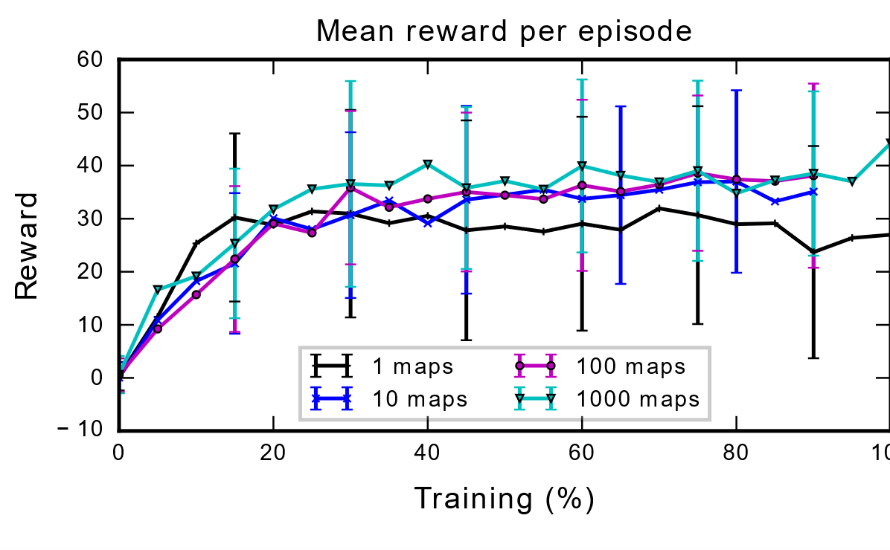
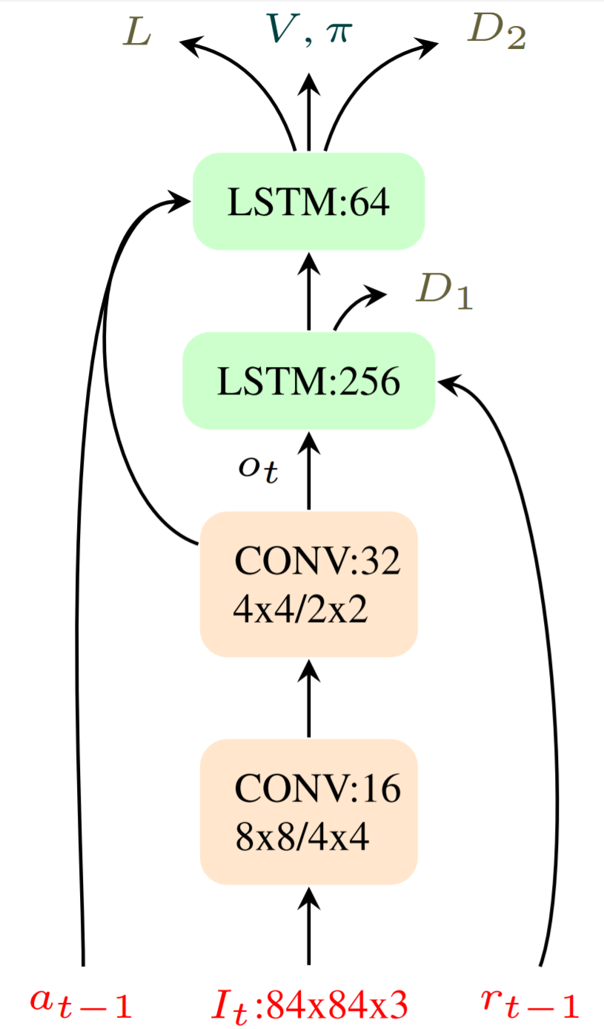
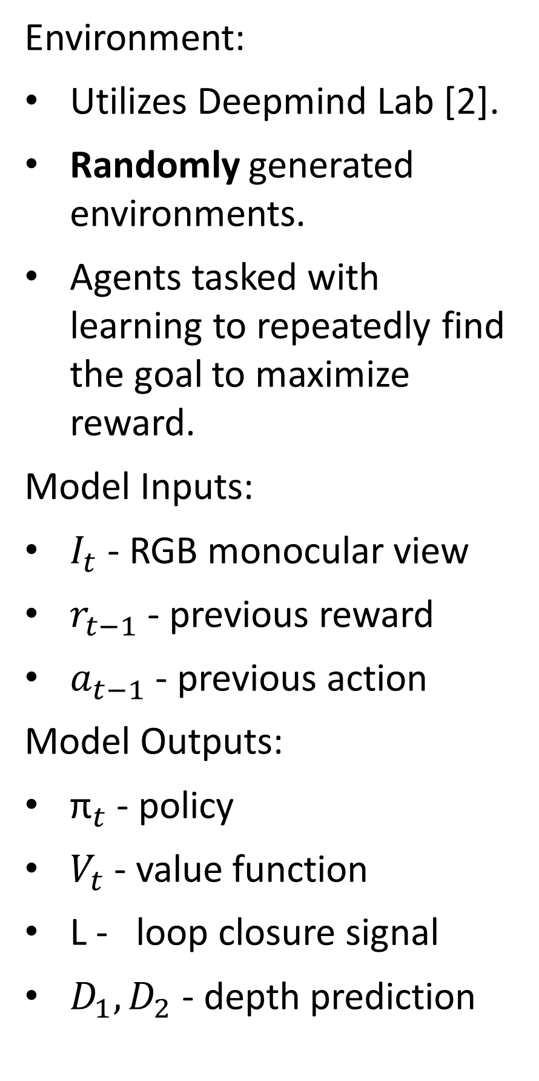

Where is the Kitchen? (Mapping)
Where am I relative to Kitchen? (Localization)
What is the shortest path to Kitchen? (Path-planning)
How do I execute the shortest path? (Control)
Objective and Contributions
We empirically analyze Mirowski et. al’s (2016) NAV-A3C-D1-D2-L deep reinforcement learning method for navigation across a wide variety of environments and starting conditions and discover that learned navigational abilities do not generalize to previously unseen environments.
Motivations:
DRL-based navigation methods have demonstrated strong performance in learning to find a goal in challenging environments.
It is unknown whether agents thus trained are performing any path-planning or mapping in their navigation.
Contributions:
Empirical analysis of this method across a wide variety of environments and starting conditions.
Empirical analysis of the performance of this method on previously unseen environments.
The DRL Navigation Challenge
We randomly generate 1000 training maps and 100 testing maps for our experiments.
Coincident Training/Testing Sets (Static Maps):
10 maps are randomly selected from the training set.
Agents are trained and tested on the same map under differing starting conditions:
static goal, static spawn
static goal, random spawn
The experiments analyze how well agent’s can remember and exploit goal location information in explored environments
Separated Training/Testing Sets (Random Maps):
Agents are trained on increasing subsets {1, 10, 100, 500, 1000} of the training set and tested on the testing set.
The experiments analyze whether these learned navigational abilities extend to unknown environments.
random goal, static spawn
random goal, random spawn
In recent years, deep reinforcement learning for navigation has arisen as a potential alternative to SLAM methods. Unlike SLAM, it combines the tasks of exploration and mapping in to a single learning framework.
Agents are trained on pure vision based monocular input. The model utilized is a modified version of the NAV-A3C-D1-D2-L architecture.
Evaluation Metrics
Latency 1:>1
Distance Inefficiency
Definition: $\frac{exploration time}{exploitation time}$
Problem Statement
Environment:
Utilizes Deepmind Lab [2].
Randomly generated environments.
Agents tasked with learning to repeatedly find the goal to maximize reward.
Model Inputs:
$I_{t}$ - RGB monocular view
$r_{t−1}$ - previous reward
$a_{t−1}$ - previous action
Model Outputs:
${\text{π}}_{t}$ - policy
$V_{t}$ - value function
L - loop closure signal
$D_{1},D_{2}$ - depth prediction

